Slide 1

6th Grade Math
Unit 9, Lesson 3 Finding and Interpreting the Mean Volume 2, pg. 154

Slide 2


Benchmark
MA.6.DP.1.2
Given a numerical data set within a real-world context, find and interpret mean, median, mode, and range.
volume 2, pg. 154

Slide 3
Integrated Mathematical Thinking and Reasoning Standards
MA.K12.MTR.4.1 Engage in discussions that reflect on the mathematical thinking of self and others.
MA.K12.MTR.7.1 Apply mathematics to real-world contexts.
volume 2, pg. 154

Slide 4

Learning Target
I can find and interpret the mean of a data set.
volume 2, pg. 154

Slide 5

Warm-Up
volume 2, pg. 154

Slide 6
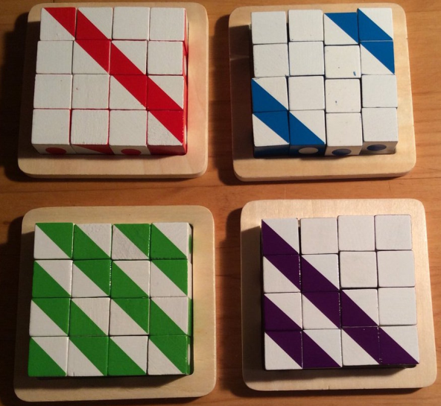
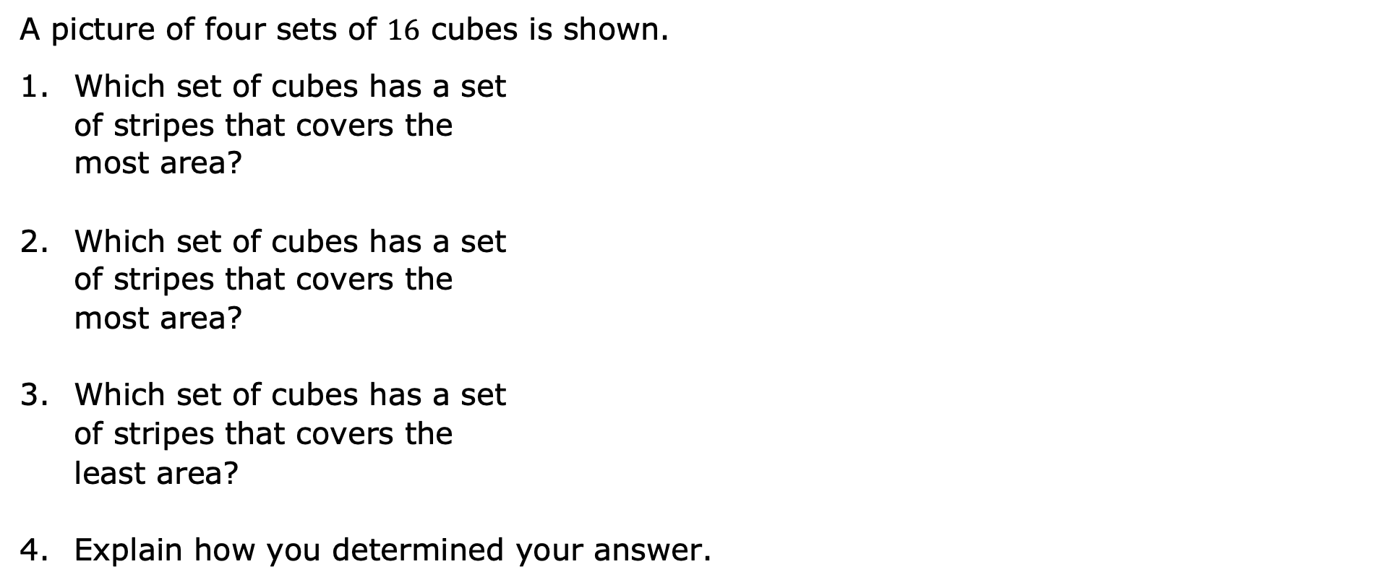
9.3.1 Warm-Up: Stripes
A picture of four sets of $16$ cubes is shown.
Which set of cubes has a set of stripes that covers the most area?
Which set of cubes has a set of stripes that covers the most area?
Which set of cubes has a set of stripes that covers the least area?
Explain how you determined your answer.
volume 2, pg. 154

Slide 7

Exploration
volume 2, pg. 155

Slide 8

9.3.2 Exploration: Sharing Squares
8
11
14
19
Estimate the number of squares that will be in each group if they were distributed evenly between the four groups.
volume 2, pg. 155

Slide 9
Use the diagram to redistribute the squares so that each of the four groups has the same number of squares.
Compare diagrams with your partner. Discuss how you each determined the number of squares that belong in each group. Summarize your discussion.
volume 2, pg. 155

Slide 10

Guided Instruction
volume 2, pg. 155

Slide 11

9.3.3 Guided Instruction: Mean of Data
By redistributing the squares in the diagram, the mean of the data set was found.
Data in a numerical set is summarized using different measures that are interpreted to describe the data. One such measure used to describe quantitative data sets is the mean.
To calculate the mean, add all the values in the data set and then divide by the total number of data values.
The mean is the arithmetic average of a set of numbers. It is a measure of central tendency.
volume 2, pg. 155

Slide 12
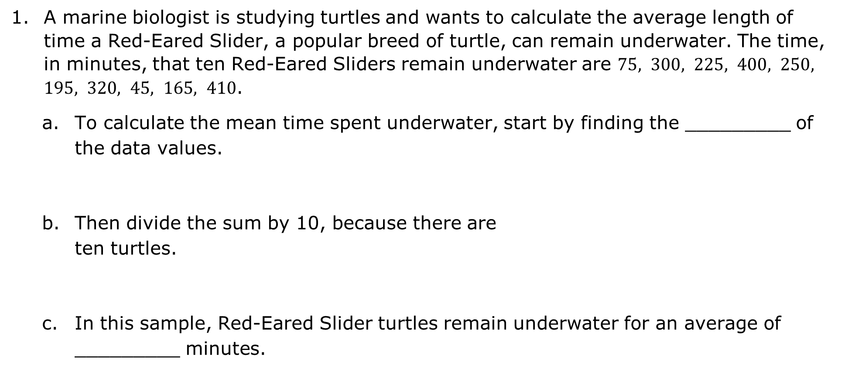
A marine biologist is studying turtles and wants to calculate the average length of time a Red-Eared Slider, a popular breed of turtle, can remain underwater. The time, in minutes, that ten Red-Eared Sliders remain underwater are $75, 300, 225, 400, 250, 195, 320, 45, 165, 410$.
To calculate the mean time spent underwater, start by finding the _________ of the data values.
Then divide the sum by 10, because there are ten turtles.
In this sample, Red-Eared Slider turtles remain underwater for an average of _________ minutes.
volume 2, pg. 155

Slide 13

Measures of center are numerical values used to describe the overall clustering of data in a set, or the overall central value of a set of data. The three most common measures of central tendency are the mean, median, and mode.
Data from the Pew Research Center on the percentage of adults in the U.S. who use Instagram is shown in the table.
Percentage of U.S. Adults Using Instagram
Year | Percentage
2012 | 13%
2013 | 17%
2014 | 26%
2015 | 29%
2016 | 34%
volume 2, pg. 156

Slide 14
Describe, in words, how to find the mean percentage of adults in the U.S. who use Instagram.
Step 1:
Step 2:
Find the mean percentage of adults in the U.S. who use Instagram. Think about what type of number the answer should be.
volume 2, pg. 156

Slide 15
Interpret the mean based on the data. Specifically address what the value of the mean states about the number of adults who use Instagram.
Explain why the mean does not give information about the percentage of adults in the U.S. using Instagram today.
volume 2, pg. 156

Slide 16
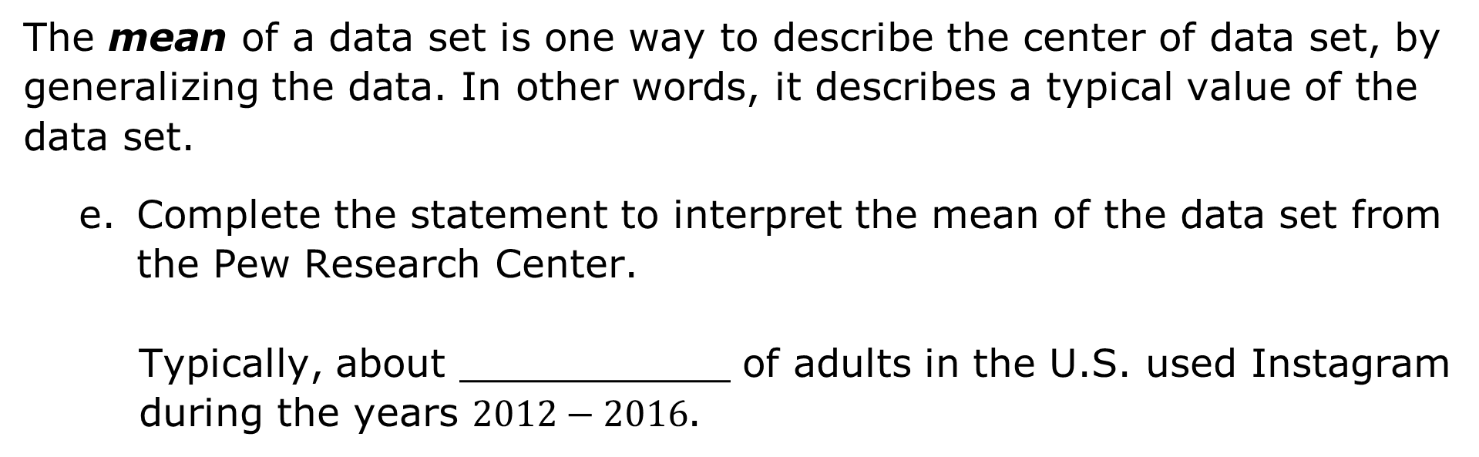
The mean of a data set is one way to describe the center of data set, by generalizing the data. In other words, it describes a typical value of the data set.
Complete the statement to interpret the mean of the data set from the Pew Research Center.
Typically, about ___________ of adults in the U.S. used Instagram during the years $2012−2016$.
volume 2, pg. 156

Slide 17

Try It
volume 2, pg. 157

Slide 18

9.3.4 Try It: Finding and Interpreting the Mean
The heights of seven NBA players are listed in the table.
What is the mean height, in inches, of the NBA players sampled? Round to the nearest tenth.
Interpret the mean height for the seven players.
Determine whether the mean should be used to make a generalization about all NBA players. Justify your answer.
Player | Height (in inches)
LeBron James | 81
Stephen Curry | 75
Kevin Durant | 82
Kobe Bryant | 78
Michael Jordan | 78
James Harden | 77
Shaquille O’Neal | 85
volume 2, pg. 157

Slide 19
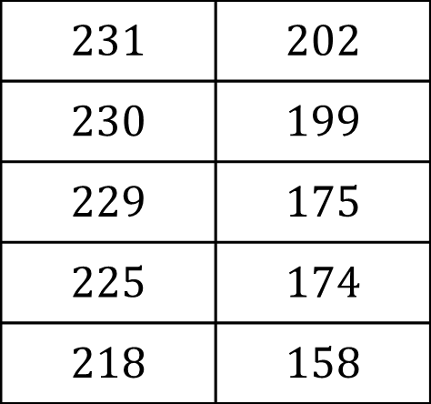
Below is a list of the number of home runs hit in the top 10 most home-run friendly ballparks during the 2012 Major League Baseball season. Circle the value from the data set that is closest to the mean number of home runs per ballpark. Show your work.
$231$ | $202$
$230$ | $199$
$229$ | $175$
$225$ | $174$
$218$ | $158$
volume 2, pg. 157

Slide 20

Your Turn
volume 2, pg. 158

Slide 21
9.3.5 Your Turn!
Statistics on the total number of visitors to Florida are tracked by Visit Florida Research. The table shows the number of visitors, in millions, for each quarter for the year 2019.
What is the mean number of people, in millions, who visited Florida per quarter in 2019? Round your answer to the hundredths place.
Visitors to Florida (in millions)
Quarter | Total Visitors
Q1 (January-March) | 35.79
Q2 (April-June) | 32.41
Q3 (July-September) | 32.40
Q4 (October-December) | 30.81
volume 2, pg. 158

Slide 22
What is the mean number of people, in millions, who visited Florida per month in 2019? Round your answer to the hundredths place.
Interpret the mean number of visitors per quarter in terms of the data set.
volume 2, pg. 158

Slide 23
For one week, Diego kept track of how long it took for his dad to drive him to school each morning.
What is the mean travel time for Diego to get to school?
Interpret the mean in terms of the data set.
Diego’s Travel Time to School (in minutes)
Day | Travel Time
Monday | 22
Tuesday | 18
Wednesday | 11
Thursday | 8
Friday | 11
volume 2, pg. 158

Slide 24
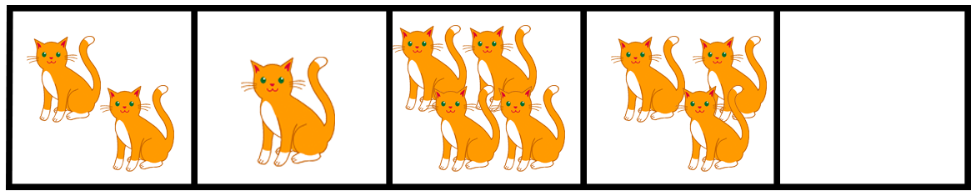

An animal shelter has $5$ crates available to hold $10$kittens. The manager of the shelter wants the kittens to be distributed equally among the crates.
How many kittens will end up in each crate?
volume 2, pg. 159

Slide 25
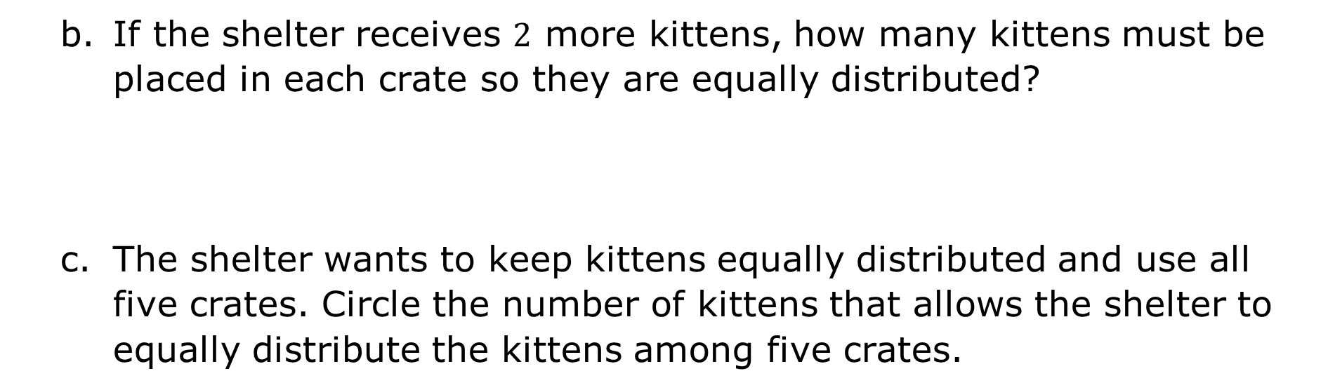
If the shelter receives $2$ more kittens, how many kittens must be placed in each crate so they are equally distributed?
The shelter wants to keep kittens equally distributed and use all five crates. Circle the number of kittens that allows the shelter to equally distribute the kittens among five crates.
$$12$$ | $$15$$ | $$6$$ | $$18$$ | $$20$$ | $$23$$ | $$9$$
volume 2, pg. 159

Slide 26

Wrap-Up
volume 2, pg. 159

Slide 27
9.3.6 Wrap-Up: Ticket Out the Door
Explain what the mean of a data set represents.
What is the average height of the bars? Draw a horizontal line across the bars to show the height of the bars if you redistributed the values so that all of the bars showed the same height.
75 61 84 92
volume 2, pg. 159

